Slide 1
Lasers

Slide 2
Laser LASER "Light Amplification by Stimulated Emission of Radiation"

Slide 3
Brief History
Milestones in the history of lasers:
1917 Einstein's treatment of stimulated emission. Einstein can be considered as the father of the laser.
1954 Townes, Schalow (USA), and Basov (Russia) suggested a practical method of achieving lasing. This was using Ammonia gas and produced amplified Microwave radiation instead of visible light (MASER).
1960 T.H. Maiman at Hughes Laboratories reports the first laser: the pulsed ruby laser
1961 The first continuous wave laser is reported (the helium neon laser).
1962 The first continuous wave semiconductor laser is reported.
1963 The first CO2 laser is reported.

Slide 4
1964: Invention of Argon Ion Laser a Hughes Lab.
1973: Discovery of laser action in quasars
1975: The first GaAs and Excimer lasers are reported.
1980: The first CW Ti:sapphire laser is reported.
1981: Carbon dioxide laser discovered in atmosphere of mars and venus
1984: First X-ray laser
1997: Steven Chu, Claude Cohen-Tannoudji and William D. Phillips get the Nobel Prize for “development of methods to cool and trap atoms with laser light.”
1999: Nobel Prize in Chemistry Ahmed Zewail for ultrafast spectroscopy
2005: John L. Hall and Theodor W. Hänsch, " Development of laser-based precision spectroscopy, including the optical frequency comb technique".

Slide 5
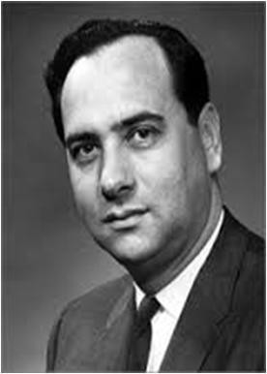
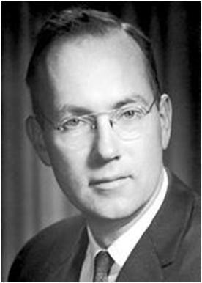
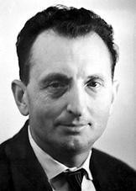
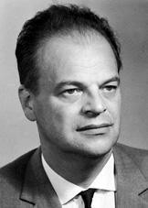
Physicists – laser The 1964 Nobel Prize for physics was shared by 3 physicists—2 Russians, Nikolay Gennadiyevich Basov (1922-2001) and his teacher Aleksandr M. Prokhorov (1916-2002), and 1 American, Charles H. Townes (1915)—for basic research in the field of experimental physics.
Maiman (1960) Towens Prokhorov
Nobel prize winners for laser
Basov

Slide 6
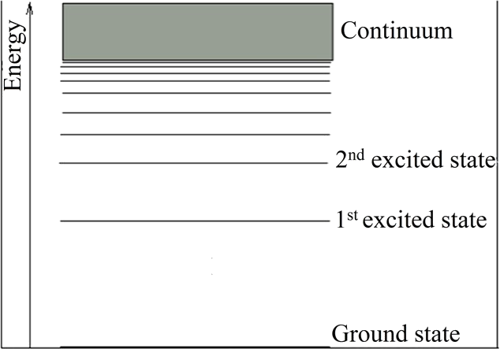
Introduction
Energy levels - discrete - atom, ions and molecules
Lowest possible energy level - ground state and higher energy levels - excited states
Energy, separation between adjacent energy levels become smaller and smaller until separation becomes so small that energy levels appear continuous - continuum

Slide 7
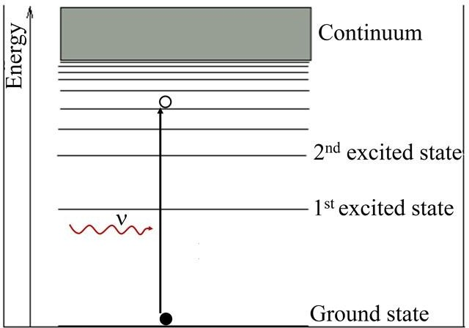
Absorption
An electron in one of lower level (ground state or a lower lying excited state) with energy E_{i} can make a transition to a higher level having energy E_{f} by absorbing an incident photon
Absorption can occur only when frequency of incident radiation:
Otherwise matter becomes
transparent to incident radiation

Slide 8
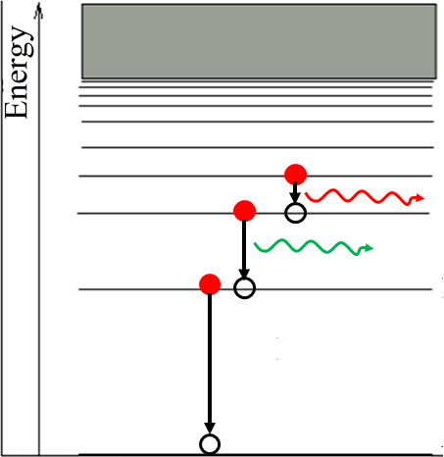
Spontaneous Emission
Atoms in excited states are not in thermal equilibrium with their surroundings
Such atoms will eventually return to their ground state by emission of a photon
If E* energy in excited state and E energy of a lower lying state (which could be ground state), frequency of emitted photon is given by:
∗

Slide 9
Stimulated Emission
In 1917, Einstein: Under certain conditions, emission of light may be stimulated by radiation incident on an excited atom
when electron in excited state E* and a photon whose energy is equal to difference between E* and energy E of a lower lying level (could be ground state) is incident on atom
Incident photon induces electron in excited state to make a transition to lower level by emission of a photon
Emitted photon travels in same direction as incident photon
New photon has same energy as that of incident photon and is perfectly in phase with it
When two waves travel in same direction with a constant phase relationship, they are said to be coherent

Slide 10
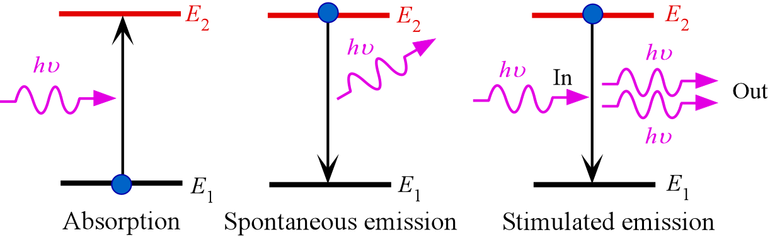
Laser System

Slide 11
LASER - Light Amplification by Stimulated Emission of Radiation
In 1958, Charles H. Townes and Arthur L. Schawlow - effect of stimulated emission can be amplified to produce a practical source of light, which is coherent and can travel long distances without appreciable spread of beam width
Such a light source called LASER, an acronym for Light
Amplification by Stimulated Emission of Radiation
Start with one photon which strikes an atom in an excited state and releases a photon, we would have two photons and an atom in the ground state
These two photons, in turn, may be incident on two more atoms in excited states and give rise to four photons, and so on

Slide 12
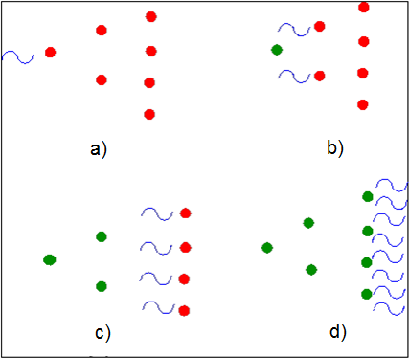
LASER
Electron remains in an excited state
~ 10⁻⁸ s
Thus it is difficult to keep atoms in excited states till they are stimulated to radiate a photon
Excited atom is more likely to de-excite spontaneously
Photons released through spontaneous processes emitted in random directions and not coherent with incident photon
Photons incident and generated may be absorbed by atoms in ground states, leading to depletion in number of photons

Slide 13
Interaction of Radiation with Matter
To have an insight into principle of laser, we need to understand the way radiation field interacts with matter
In early
₂₀th
century, Planck formulated theory of spectral
distribution of thermal radiation
Einstein, by combining Planck's theory and Boltzmann statistics
gave a theory of stimulated emission - governing principle of lasers

Slide 14

Blackbody Radiation
Planck's formula gives radiation of radiant intensity when electromagnetic radiation confined to an isothermal cavity - known as blackbody
In classical physics, radiation is considered as waves which form standing wave pattern in cavity with nodes at walls
Classical formula for radiant energy density u(ν) at frequency ν in energy interval to (ν + dν ): number of modes of electromagnetic
waves in this interval × average energy per mode kT
Rayleigh- Jeans' Law:
Unphysical result in short wavelength region (known as ultraviolet catastrophe)

Slide 15
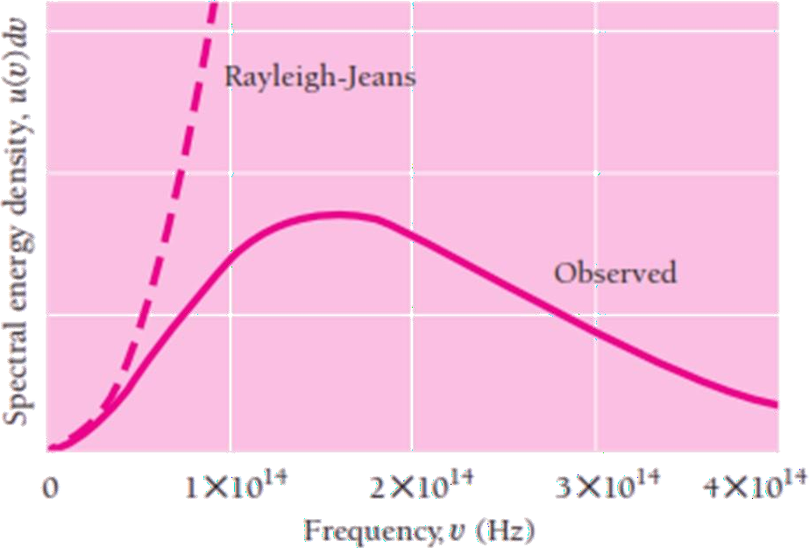
Blackbody Radiation

Slide 16
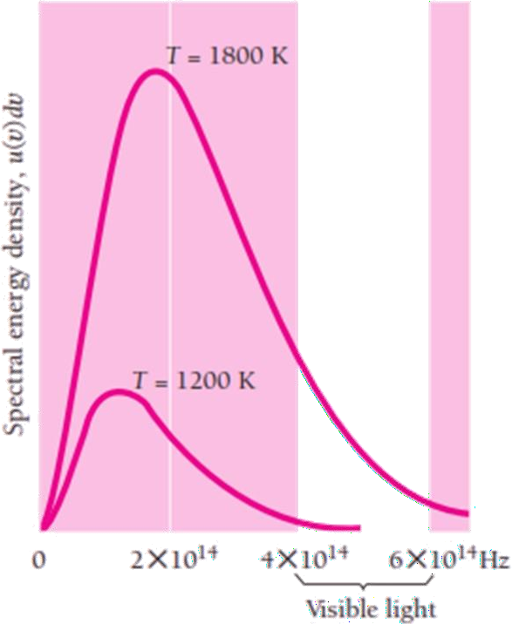
Blackbody Radiation
Planck
suggested oscillating atoms
could emit or absorb energy in tiny
bursts called quanta, energy quantum being proportional frequency
of a to its
Planck's formula for radiant energy density:

Slide 17
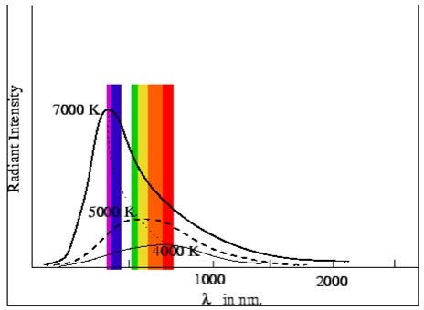
Blackbody Radiation
Using Planck's law one can show that total power emitted by a blackbody at temperature T is:
Emitted radiation has a peak at wavelength 𝜆_{𝑚𝑎𝑥} give by Wien's Displacement Law:
For instance,
a blackbody at a
a
temperature of 5000 K has
radiation peak at 580 nm, which is
near middle visible region

Slide 18
Boltzmann Statistics
Two level system: N₁ number of atoms per unit volume in energy
level E₁ and N₂ in higher energy level E₂.
E₁ – E₂ =hν
Total population density in the system: N₁ + N₂
At thermal equilibrium with surrounding at a temperature T, relative population in two levels by Boltzmann distribution:
As temperature increases, population of excited states increases
However, population of an excited state always lies lower than population of ground state, under equilibrium condition
For large energy gaps such that ℎ𝜐 ≫ 𝑘𝑇, ratio is close to zero so that very few atoms are in upper energy state

Slide 19
Boltzmann Statistics
When two or more states have same energy, states are said to be degenerate
Number of states at same energy level is called multiplicity of
energy level
As all states having same energy have same population, we have
•
where 𝑔₁ and 𝑔₂, respectively, are multiplicities of levels
E₁ and E₂

Slide 20
Einstein Relations - A and B Coefficients
Distribution of atoms in two energy levels will change by absorption or emission of radiation
Einstein introduced three empirical coefficients to quantify change
of population of two levels
Stimulated Absorption: Population of upper level will increase due to absorption of radiation by atoms in lower level
Rate is proportional to population of atoms in lower level N₁ and to
energy density 𝑢 𝜐 of radiation in system:
If B₁₂ is probability (per unit time) of absorption of radiation, rate of
increase of population of excited state:
where 𝐵₁₂ constant of proportionality (m³s⁻²J⁻¹)

Slide 21
Einstein Relations - A and B Coefficients
Spontaneous Emission: Population of upper level will decrease due to spontaneous transition to lower level with emission of radiation
Rate of emission will depend on population of upper level
If A₁₂ is probability that an atom in excited state will spontaneously decay to ground state:
lifetime of an atom in excited level before returns to ground state
Spontaneous emission depends on lifetime of atom in excited state
Process is statistical and emitted quanta bear no phase relationship with one another, i.e. the emission is incoherent

Slide 22
Einstein Relations - A and B Coefficients
Stimulated Emission: depends on number of atoms in excited level as well as on energy density of incident radiation
If B₂₁ be transition probability per unit time per unit energy density of
radiation, rate of decrease of population of excited state is
Rate equation for the population of the upper level is:

Slide 23
Einstein Relations - A and B Coefficients
When equilibrium is reached, population of levels remains constant, so that

Slide 24
Einstein Relations - A and B Coefficients
If we regard matter to be a blackbody and compare above expression for energy density with corresponding energy density expression derived for blackbody radiation:
In absence of degeneracy, probability of stimulated emission is equal to that of stimulated absorption
In view of this, replace two coefficients by single coefficient:
B - coefficient
Spontaneous emission coefficient: A - coefficient.

Slide 25

Einstein Relations - A and B Coefficients
Ratio of spontaneous emission probability to stimulated emission probability is:
For low temperatures, when spontaneous emission is
much more probable than induced emission and latter may be neglected
For high enough temperatures, stimulated emission probability can be significant though for optical frequencies, this requires very high temperature
For microwave frequencies, stimulated emission processes may be significant even at room temperatures

Slide 26
Population Inversion
When atoms are in equilibrium with surrounding, population of atoms in ground state is more than that in any of excited states
Population of excited states can be increased by absorption of radiation
However, life time in excited states being typically of the order of 10⁻⁸ s, atoms which make transitions to excited states fall back to ground state soon thereafter
This is also indicated by ratios of Einstein coefficients
It is, therefore, not possible to keep population in excited states higher than that in ground state
Basic principle involved in operation of laser is population inversion, a situation in which population of excited state is kept higher than that of ground state

Slide 27
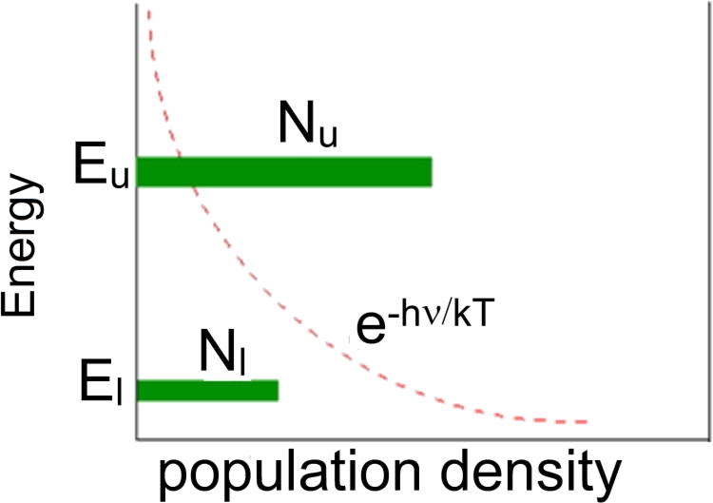
Population Inversion
When N_{u} < N_{l} , i.e., the population in upper level is less than that in lower level, number of transitions from lower to upper level with absorption of radiation is more than that with emission and hence radiation is attenuated
If, on the other hand, N_{u} > N_{l} , emissions are more than absorption and radiation is amplified as it passes through the material.

Slide 28
Pumping Methods
Depending upon the type of laser, the most commonly used pumping methods are
a) Optical pumping: In this, the population inversion is achieved by means of light energy delivered from appropriate pumping source such as gaseous discharge or flash tubes. For example, in ruby laser, xenon flash tube is used.
b) Electric discharge pumping: this type of pumping accomplished by means of intense electrical discharge in the medium and is particularly suited to gas media like HeNe laser and CO2 laser. The electric discharge coverts the gas into a plasma where active centers collide in-elastically with free electrons and population inversion is achieved.
c) Chemical pumping: It raises active centers into the higher levels by means of suitable exothermal chemical reactions in the active medium. For example, H₂ + F₂ → 2HF, in this chemical reaction, hydrogen (H₂) and fluorine (F₂) molecules are chemically combined to produce hydrogen fluoride molecule (2HF) in an excited state.
d) Heat pumping: In this type of pumping, the active material is first brought to a high temperature then rapidly cooled down.

Slide 29
Pumping Methods
e) Direct Conversion; In this method, due to electrical energy applied in direct band gap semiconductor like Ga As, recombination of electrons and holes takes place. During the recombination process, the electrical energy is directly is converted into light energy.
f) In elastic atom-atom collision: In this method, a combination of two gases (Say A and B are used). The excited states of A and B nearly coincides in energy.
In the first step during the electrical discharge atoms of gas A are excited to their higher energy state A* (metastable state) due to collision with the electrons .
A + e* = A* + e
Now A* atoms at higher energy state collide with b atoms in the lower state. Due to inelastic atom - atom collision B atoms gain energy and they are excited to a higher state B* . Hence, A atoms lose energy and return to lower state.
A* + B = A + B*

Slide 30
Threshold condition (Schawlow and Townes equation)
This equation is known as Schawlow–Townes condition for laser oscillations.
The population difference required to make laser oscillations depends on the two life times, the spontaneous life time of the upper energy level and the effective decay time of the cavity

Slide 31
MASER
Maser: Microwave Amplification by Stimulated Emission of Radiation
Townes, 1951,
devised method to amplify microwaves
Wavelength about 1 cm.
Townes with PhD student Gordon demonstrated this using ammonia molecules in April 1953.
This was first MASER

Slide 32
MASER
Frequency of microwave photons is 10¹³ Hz, corresponding to an energy of the order of 0.01 eV
Energy is of same order as that of thermal energy of air molecules
In such a case, population of excited states is comparable to that of the ground state at room temperatures
process of stimulated emission can then be used to amplify microwave signal
MASER is an acronym for Microwave Amplification by Stimulated Emission of Radiation

Slide 33
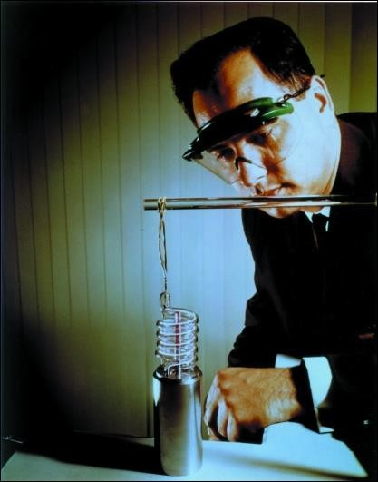
LASER
16 May, 1960,
Theodore H Maiman, Hughes Labs, generated a laser beam wavelength 694 nm from a ruby rod in a coiled
flash lamp.
Paper submitted for publication Rejected.
Results announced in New York Times, 8 July 1960.
Paper accepted by “Nature”, appeared 6 August 1960.

Slide 34
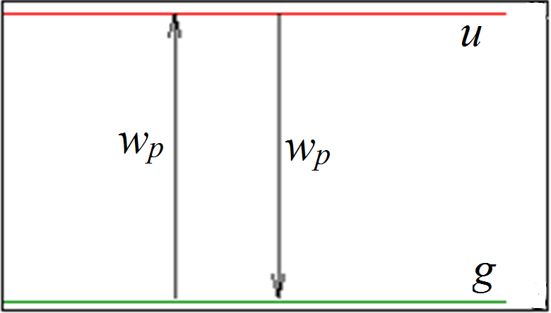
Rate Equations for a Two Level System
A two level system with upper level u and ground level g
In order that laser transition may occur, we need a population inversion
As at normal temperatures, population of lower level is more than that at upper level, atoms must be pumped into upper level by providing them energy equal to the energy difference between two levels.

Slide 35
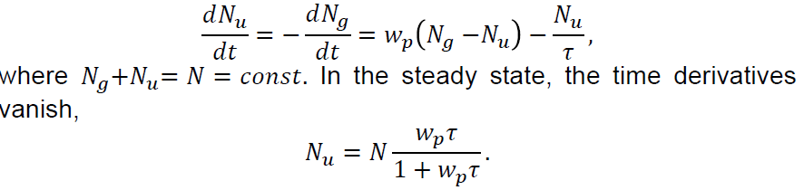
Rate Equations for a Two Level System
If B_{p} is pumping induced transition rate for N_{g} → N_{u} or N_{u} → N_{g} and τ is natural lifetime of atoms in upper level, rate equation for two levels:
In order that a population inversion may take place, we must have
𝑁_{𝑢} > 𝑁_{𝑔}.
Thus population inversion is not possible in a two level system

Slide 36
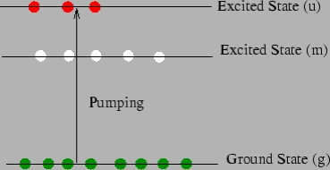
Three Level Laser
For optical frequencies, population inversion cannot be achieved in a two level system
In 1956 Bloembergen proposed a mechanism in which atoms are pumped into an excited state u by an external source of energy (such as by an electric pulse or by optical illumination)

Slide 37
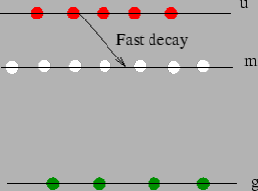
Three Level Laser
The system, in addition to state u, has an excited state m which is a metastable state, i.e. a state in which atom has a longer life time
Atoms u decays spontaneously to metastable state m
Life time in level m is such that rate of spontaneous decay from level m to ground level g is slower than rate at which atoms decay from u to m.
This results in a population inversion between metastable level and
ground state

Slide 38
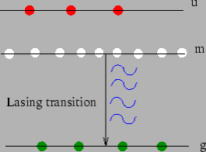
Three Level Laser
Emitted photons are confined to a laser cavity to stimulate further emission from excited atoms
Ruby laser works on principle of a three level system
pumping power required for such a system is very high because more than half of ground state atoms have to be pumped into upper level to achieve population inversion

Slide 39
Three Level Laser
As N_{m} ≅ N_{g} = N/2 and N_{m} − N_{g} << N, once the population inversion is achieved, power required to maintain it is small
u → m transition is generally radiation less, the energy being given away to lattice
As more than half of atoms are to be raised to the level m, the probability of spontaneous emission is also much higher
Laser transition occurs from metastable state to lowest possible state which are well separated
This leads to low efficiency

Slide 40
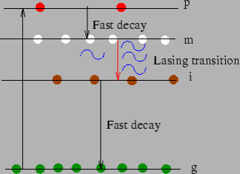
Four Level Laser
One of most popular and low cost lasers is helium-neon laser, which works on the basis of a four level system with two levels intermediate between the ground state g and pump level p
Ground state atoms are electrically pumped to a short lived state p
Atoms from this state undergo fast decay to a metastable state m
Between m and g, yet another short lived excited state i exists
A population inversion takes place between this intermediate state i
and metastable state m, between which the lasing transition occurs
population inversion occurs even for very small pumping power

Slide 41
LASER
Components
Active medium - semiconductors, gases excitation
solid
(CO₂, He-Ne, Ar-ion), liquid dyes -
crystals
(Ruby,
Nd:YAG),
Excitation Source – optical (flash lamps), electrical (discharge)
– population inversion
Resonator - Highly reflective (100 %) and partially transmissive mirrors (95 %)

Slide 42
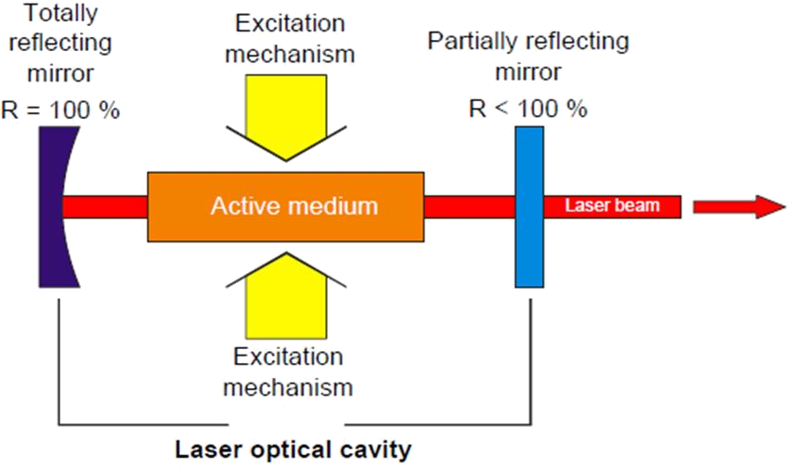
Laser System

Slide 43
Resonator
Optical cavity, resonating cavity or optical resonator
Laser radiation can circulate and pass a gain medium which compensates optical losses
Light confined in cavity reflects multiple times producing standing waves for certain resonance frequencies
Standing wave patterns produced are called modes; longitudinal modes differ only in frequency
Transverse modes differ for different frequencies and have different intensity patterns across the cross section of the beam.

Slide 44
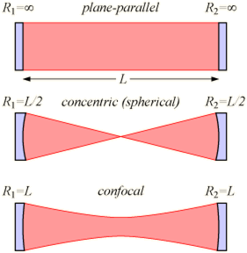
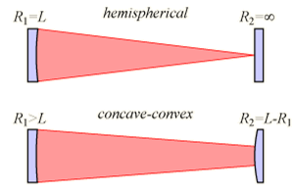
Resonator

Slide 45
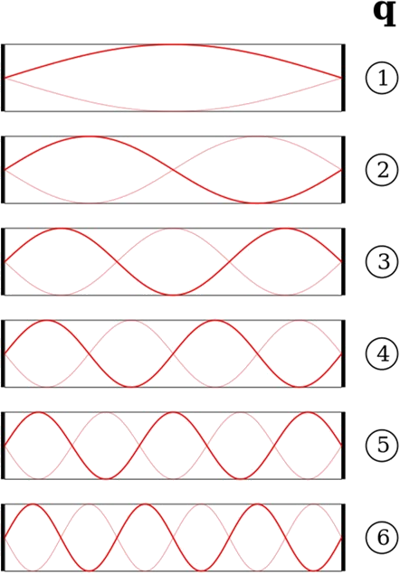
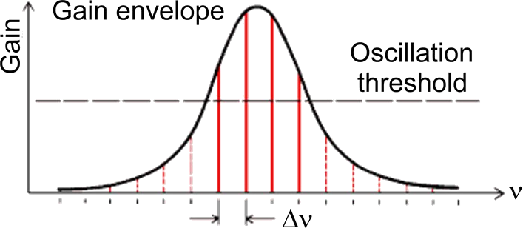
Resonator – Longitudinal Modes

